Slide 1



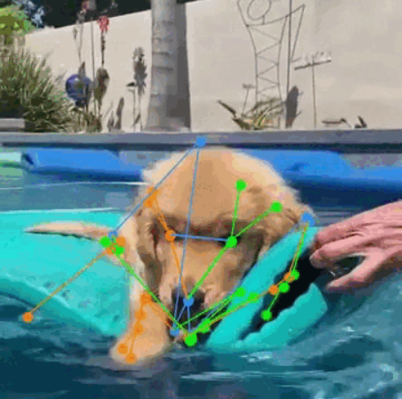
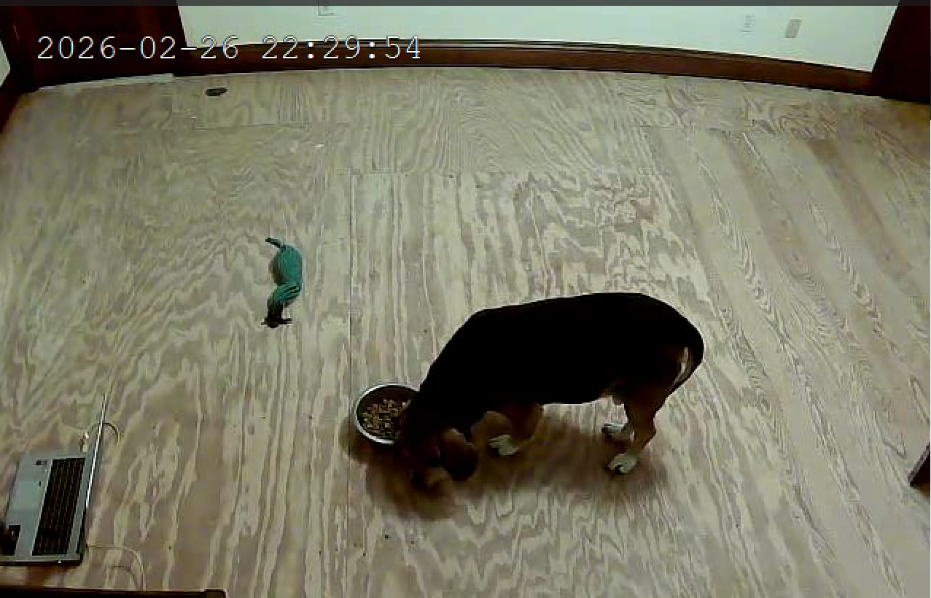
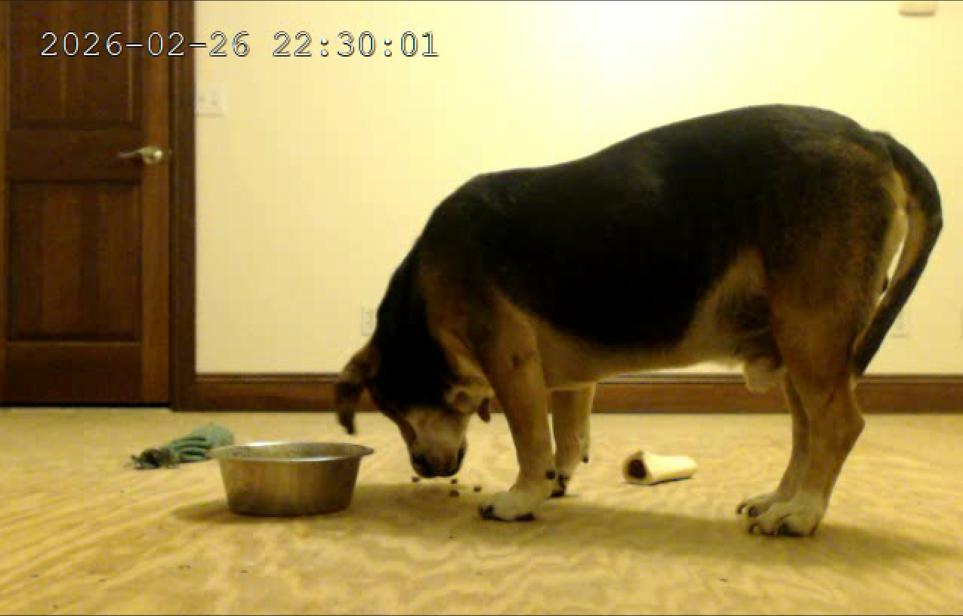
Dog Pose Estimation and Behavior Inference Using Pose Detection Models:
By: George Abounader
Teammates:
Leader: Raiyan Ashraf
Coworkers: Colin Grant
Abstract
The limited availability of specialized pose estimation models for dogs, combined with the challenge of automatically interpreting canine behavior, presents a significant problem in dog gesture recognition. Over the course of this year, a study was conducted to investigate dog gesture recognition. The primary objective was to design and develop a model to accurately detect a dog’s pose, and be able to infer the behavior of the dog through the pose. This study utilized MMPose, a pose recognition model to achieve better accuracy. By fine-tuning this pose detection model through data, dog gesture recognition can improve. By enhancing dog gesture recognition, this research can improve communication between dogs and humans, and advance the effectiveness of dog monitoring systems. Throughout the project, data collection, research, and testing, was conducted all of which furthered the development of the model. Data collection through recordings of dog behavior, research through model documentation and research papers, and testing through the evaluation of the dog gesture recognition model.
Pose Models
This model uses a combination of different models. These models being YOLO, and Mmpose. Each model used to serve a different purpose. For instance, Mmpose was used to detect what the dog was physically doing. Another example, would be YOLO being used to detect if there is a actually a dog in the video.
Example
YOLO detects if dog is there
MMpose draws the joints for the dog
Input
Problem/Objective
Present day dog monitoring systems are ineffective with automatically knowing what the dog is doing at all times. The main objective of this study is to make a model that can detect a dog and infer what the dog is doing and feeling.
Benefits
Model infers what the dog is doing
With this dog detection model the model can infer if the dog is hungry and give it food. Another benefit is if it infers that the dog is not feeling well it can notify the human about the problem. Overall helping the human understand what the dog needs and wants.
Plans For the Future
In the future the plan for this project is too get a working model. Once we get a working model we can implement the model into a dog feeder and test the dog feeder on actual dogs.

